Slide 1
Counting
CSI 219 – Discrete Mathematics

Slide 2
Permutation
Permutation: In how many ways can we select r elements from a set of n elements, such that the order of the selected elements matter.
For example: How do we choose 5 students out of 10 and arrange them in one line?

Slide 3
Permutation
Ordered arrangement of distinct objects

Slide 4
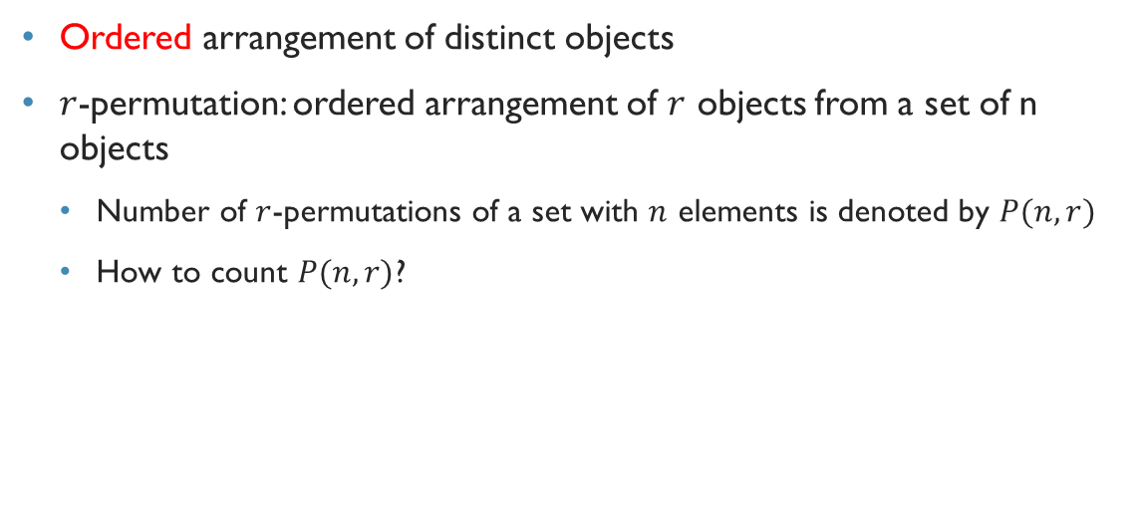
Permutation
Ordered arrangement of distinct objects
$r$-permutation: ordered arrangement of $r$ objects from a set of n objects
Number of $r$-permutations of a set with $n$ elements is denoted by $P(n,r)$
How to count $P(n,r)$?

Slide 5
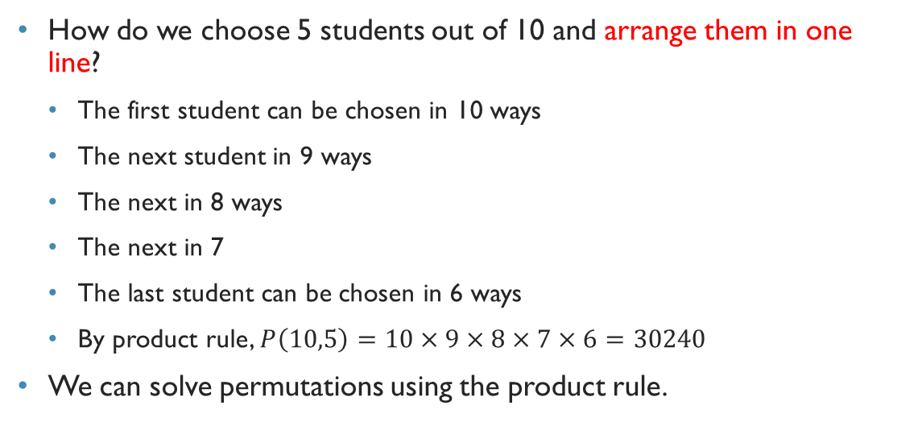
Permutation
How do we choose 5 students out of 10 and arrange them in one line?
The first student can be chosen in 10 ways
The next student in 9 ways
The next in 8 ways
The next in 7
The last student can be chosen in 6 ways
By product rule, $P\left(10,5\right)=10×9×8×7×6=30240$
We can solve permutations using the product rule.

Slide 6
Permutation
We can solve permutations using the product rule:
If we want to fill r positions from a set of n elements, such that their order matters, that is, P (n, r):
We have n choices for the 1st position
n – 1 choices for the 2nd position
n – 2 choices for the 3rd position
Do you see a pattern?
For the x^{th} position, we will have (n – x + 1) choices
Therefore, we will have n – r + 1 for the last (i.e., r^{th} position)

Slide 7

Permutation
Therefore:
P (n, r) = n * (n - 1) * (n - 2) * ….. * (n – r + 1)
This can be written as:
P (n, r) = $\frac{n!}{\left(n−r\right)!}$

Slide 8
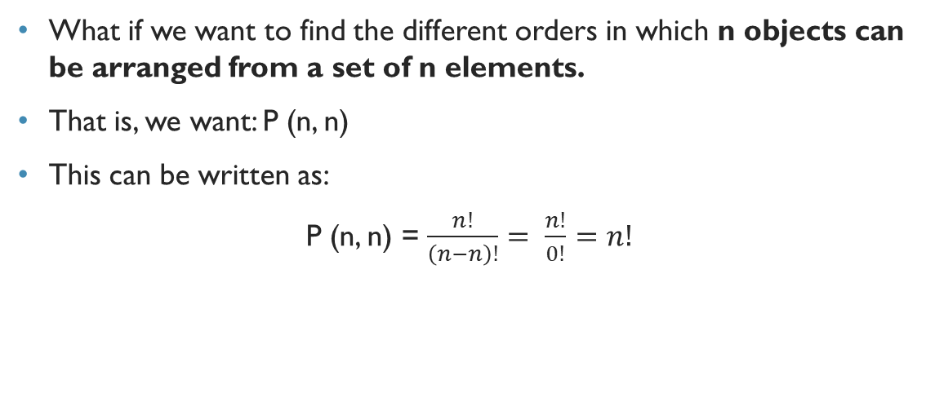
Permutation
What if we want to find the different orders in which n objects can be arranged from a set of n elements.
That is, we want: P (n, n)
This can be written as:
P (n, n) = $\frac{n!}{\left(n−n\right)!}= \frac{n!}{0!}=n!$

Slide 9
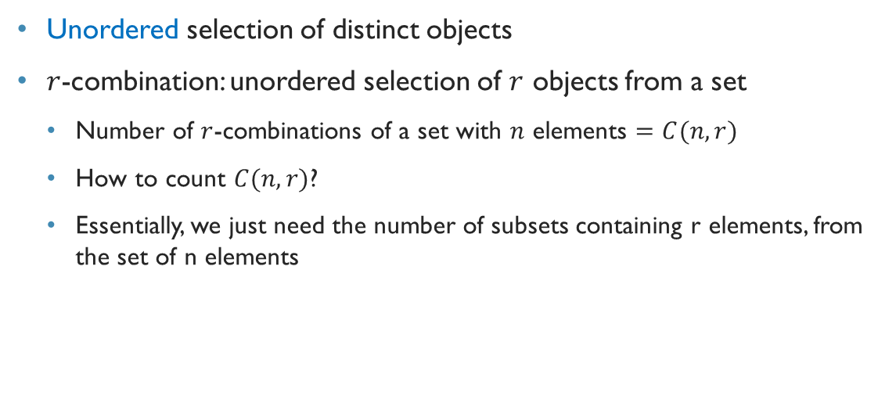
combination
Unordered selection of distinct objects
$r$-combination: unordered selection of $r$ objects from a set
Number of $r$-combinations of a set with $n$ elements $=C(n,r)$
How to count $C(n,r)$?
Essentially, we just need the number of subsets containing r elements, from the set of n elements

Slide 10
combination
Suppose we want to select 2 students for the same position of a committee from 4 students -- C(4, 2)
Consider the 4 students to be a set of 4 elements, where each element is a student:
{a, b, c, d}
How many subsets containing 2 elements can we have?
{a, b} {a, c} {a, d} {b, c} {b, d} {c, d}
Note that, here, the order in which we select the elements (students) do not matter. {a, b} is the same as {b, a}
Therefore, C(4, 2) is 6.

Slide 11
Let’s find out a better way to compute Combinations!
Let’s go back to permutation again!
How many ways can we have r-permutations from a set of n elements?
Find out P (n, r)
We can now solve this permutation, P(n, r), a bit differently:
Take all the combinations of subsets containing r elements, i.e., C (n, r)
Find out the different permutations of each of the r-element subsets, that is, find out P (r, r)
P (n, r) = C (n, r) * P (r, r)

Slide 12

Let’s find out a better way to compute Combinations!
P (n, r) = C (n, r) * P (r, r)
$$C \left(n, r\right)= \frac{P (n, r)}{P (r, r)}$$
$$C \left(n, r\right)= \frac{n!}{\left(n −r\right)!}÷r!$$
$$C \left(n, r\right)= \frac{n!}{\left(n −r\right)!r!}$$

Slide 13

Combination
In general, we can deduce the following:
$$C\left(n,r\right)=\frac{P\left(n,r\right)}{r!}$$
$$C\left(n,r\right)=\frac{P\left(n,r\right)}{r!}=\frac{n!}{\left(n−r\right)!}×\frac{1}{r!}=\frac{n!}{r!\left(n−r\right)!}$$

Slide 14
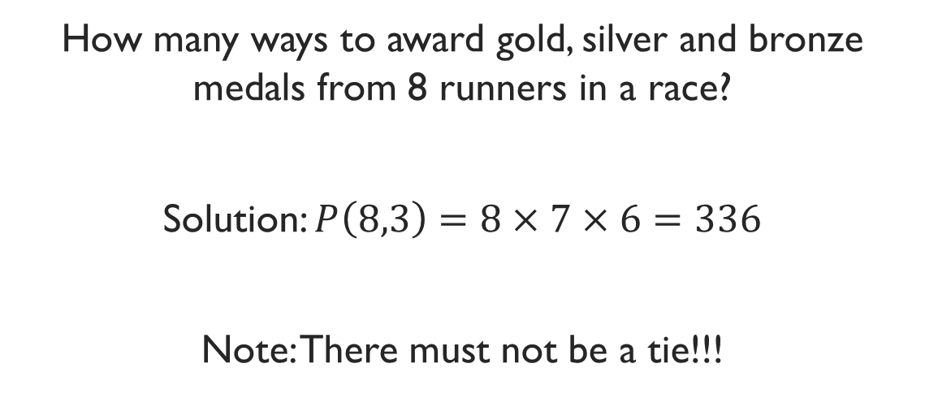
Example
How many ways to award gold, silver and bronze medals from 8 runners in a race?
Solution: $P\left(8,3\right)=8×7×6=336$
Note: There must not be a tie!!!

Slide 15
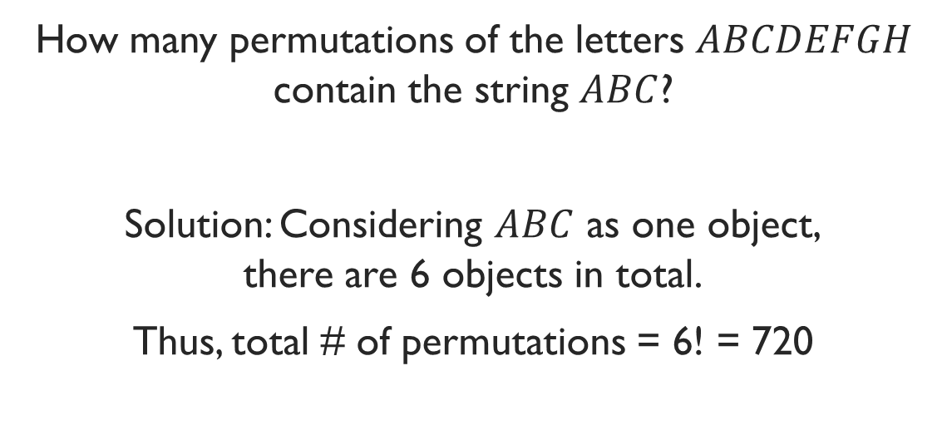
Example
How many permutations of the letters $ABCDEFGH$ contain the string $ABC$?
Solution: Considering $ABC$ as one object, there are 6 objects in total.
Thus, total # of permutations = 6! = 720

Slide 16
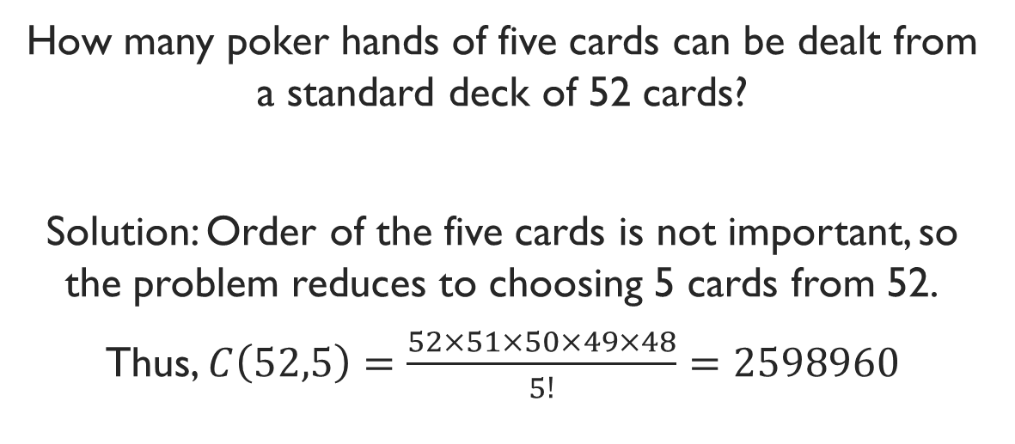
Example
How many poker hands of five cards can be dealt from a standard deck of 52 cards?
Solution: Order of the five cards is not important, so the problem reduces to choosing 5 cards from 52.
Thus, $C\left(52,5\right)=\frac{52×51×50×49×48}{5!}=2598960$

Slide 17
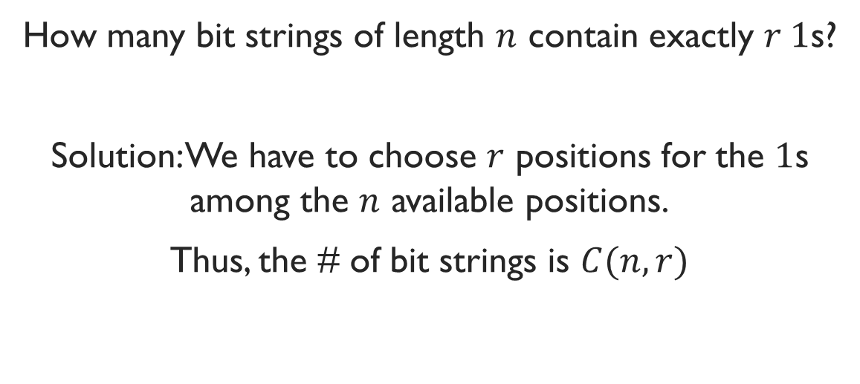
Example
How many bit strings of length $n$ contain exactly $r 1$s?
Solution: We have to choose $r$ positions for the $1$s among the $n$ available positions.
Thus, the # of bit strings is $C(n,r)$

Slide 18
Example
How many bit strings of length 10 contain
a) exactly four Is?
b) at most four Is?
c) at least four Is?

Slide 19
Exercise
There are 9 Math faculties and 11 CS faculties in a university. The authority wants to form a committee to develop a Discrete Math course, such that 3 members of the committee are Math faculties, and 4 are CS faculties. The members will all be in the same position
How many ways to form the committee?

